Slide 1
GPS –Robotic Process Automation Using UiPath
Rahil Akram
IBM India Pvt Ltd – AT&T Account

Slide 2
Contents
What is Robotic Process Automation
Automation v/s RPA
Lifecycle of RPA
Advantages of RPA
UiPath Architecture
UiPath Platform Components
GPS Sanity Use case using UiPath
Email Notification to Stakeholders
Benefits of Using UiPath for GPS Sanity
References – Asset Details

Slide 3
What is Robotic Process Automation?
Consider an instance, where you want to publish your articles on various social groups at a specific time every day. Would you wish to do it manually yourself or would you appoint an employee whose sole job would be to publish articles everyday? This would cost you a lot, and also would be tiresome for that employee. Isn’t it?
Instead, you could just make a robot do it for you!
You could just configure computer software or a robot to interpret human actions and imitate them.
So, here you could just configure a robot to publish the articles every day at the mentioned time. That would not only cost you less but would also be less tiresome.
So, mimicking human actions to perform a sequence of steps that lead to meaningful activity, without any human intervention is known as Robotic Process Automation.

Slide 4
Automation v/s RPA
Automation existed even before RPA came into the picture. Though multiple overlaps exist between these two, unlike RPA, Automation is the invention of a new technology to solve real-life problems with the need for human intervention.
Refer to the table to look into the differences between Automation and RPA.
Parameter | Automation | RPA
What does it Reduce? | Reduces execution time | Reduces the number of people working on something.
What does it automate? | Automates repetitive test cases i.e a product | Automates the repetitive business process i.e product as well as business
Programming Knowledge | Programming knowledge required to create test scripts | Programming knowledge is mostly not needed as it is wizard-driven
Software Environment | Limited software environment | A wide range of software environments
Application | Used for QA, Production, Performance, UAT environments | Usually used in production environments

Slide 5
Lifecycle of RPA
A typical life cycle of RPA has 4 phases. Analysis, Bot Development, Testing, and Support & Maintenance.
Analysis – Business teams & RPA Architects work together to analyze a business process for RPA development.
Bot Development – Developer teams start working on developing the automated workflows for the requirements in a distinct development environment.
Testing – Run testing cycles such as SDLC to analyze the quality and correct defects.
Support & Maintenance -After the development & testing phases, a bot enters the maintenance phases in which it provides continuous support and helps in the immediate defect resolution.

Slide 6
Advantages of RPA
Multiple processes can be automated at once.
Cost cutting technology and enhances resource optimization.
Doesn’t require prior programming knowledge.
Supports and allows regular compliance process, with error-free auditing.
Easy to model, scale, and deploy the automation process.
Makes it easy to track defects.
Continuous builds & release management.
No training period is required as it works without human intervention

Slide 7
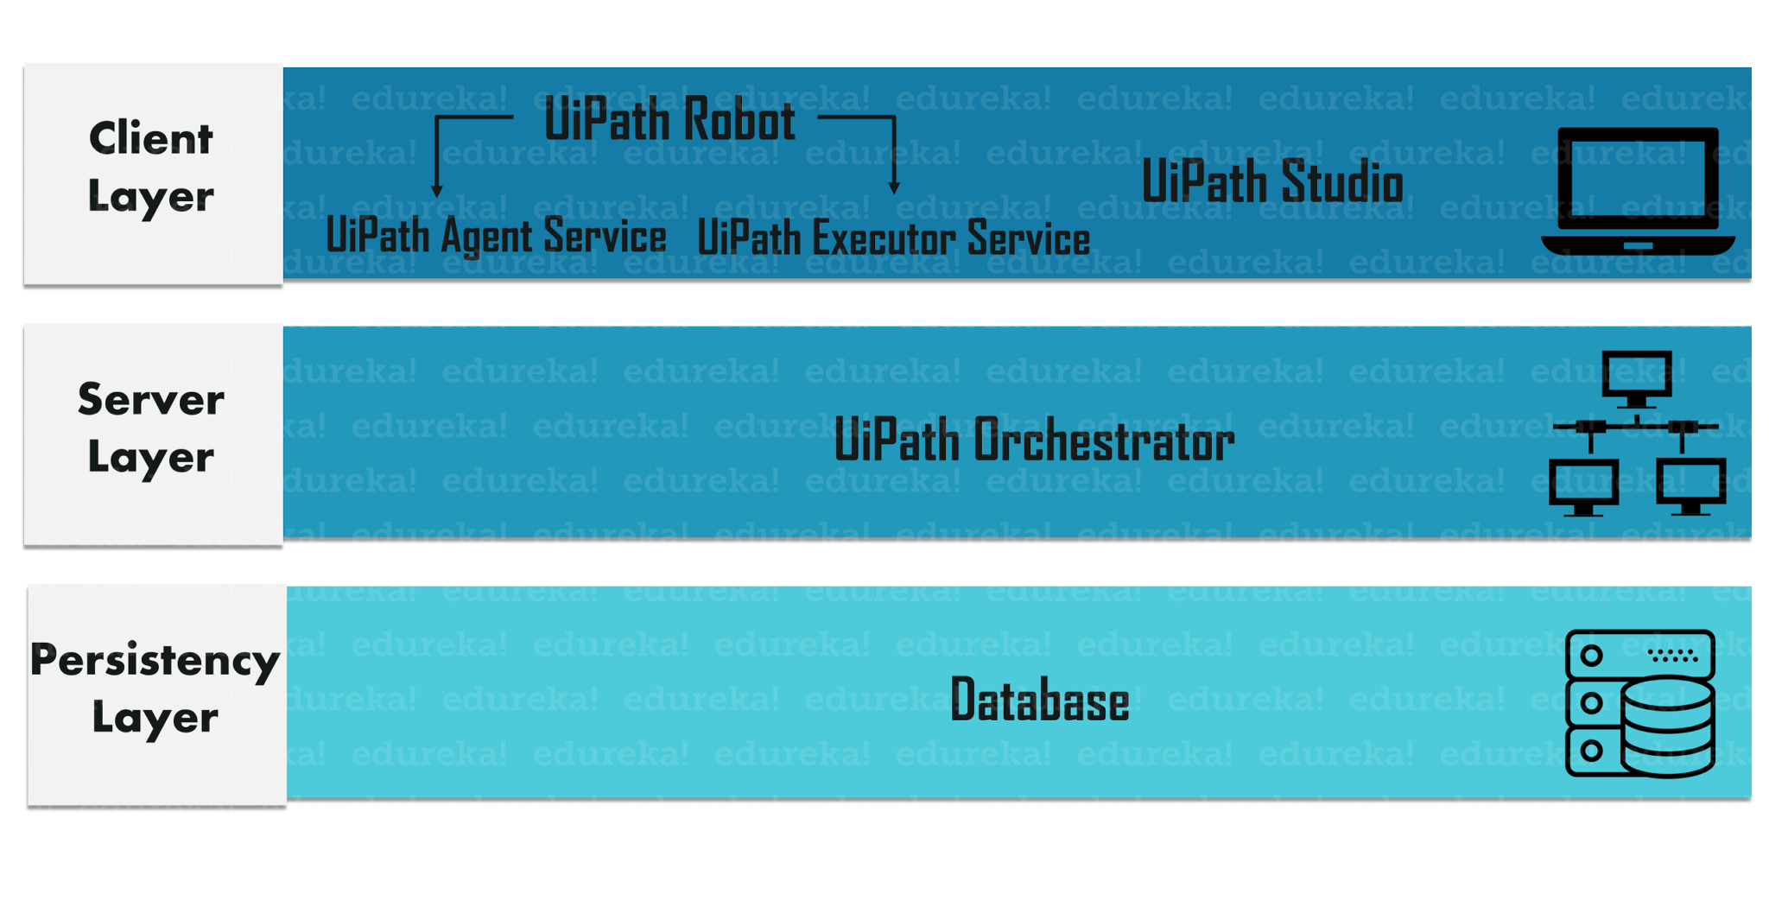
UiPath Architecture
The UiPath Architecture has the following 3 layers:
Client Layer
Server Layer
Persistency Layer

Slide 8
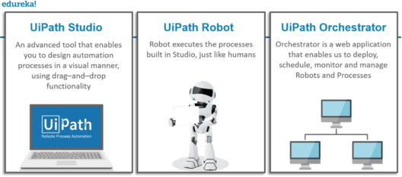
UiPath Platform Components
The UiPath Platform mainly consists of the following 3 components:
UiPath Studio
UiPath Robot
UiPath Orchestrator

Slide 9
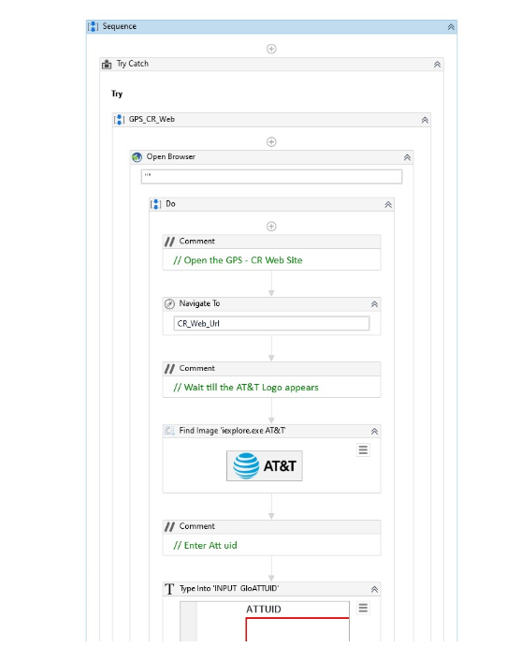
GPS Sanity Use case using UiPath
Automated CR Web / RCP screen modules using UI Path tool that uses Robotic process automation to automate Sanity test cases of GPS Application which involves 40+ complex manual steps that was performed manually on daily basis by test team earlier.
UiPath automatically runs these test suite and sends out a detailed report along with snapshot so team can review and identify the failure point. for further investigation.
This tool can be used to automate the regression / progression test cases which significantly reduces the manual effort.
One more benefit of this tool is it can automate a desktop based application which cant be achieved using Selenium.
Notes:
Sequence of the steps performed by Robot

Slide 10
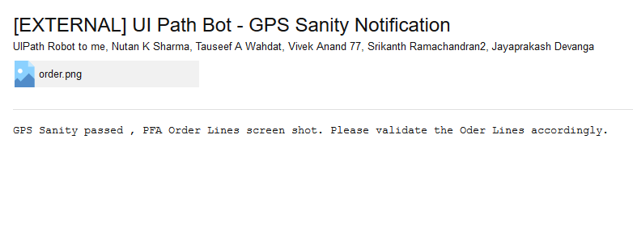
Email Notification to Stakeholders
Robot sends out a Email Notification to all the stakeholders after the execution is completed.

Slide 11
Benefits of UiPath in GPS to AT&T
Community Edition version of this tool is free of cost and for Unlimited duration.
It significantly reduces the time taken for doing sanity Activity in GPS ( From 40min == to 15 mins)
Automated failure recovery from the point of failure.
Responds to users with a screenshot of the failure point so they can take a corrective action on it.
Future Work Plan
We can automate even other screens of GPS workflow and complete the user tasks automatically. This approach can be used to Automate vast number of Regression Test cases and also Progression testing without manual steps.

Slide 12
References
Rahil Akram's Personal Room-20200523 2153-1
Saturday, May 23, 2020 | 5:53 pm | Eastern Daylight Time (New York, GMT-04:00)
Recording password: fEMMS4mJ https://ibm.webex.com/recordingservice/sites/ibm/recording/playback/5d92e6435f544f53821241281d8f0a84

